Slide 1

ZOMATO RESTAURANT
ANALYSIS
BY SUPARTH JAIN

Slide 2



Zomato Restaurant Analysis
DATA CLEANING
BUSINESS SOLUTION
DATA TRANSFORMATION
DASHBOARD CREATION
DATA ANALYSIS
DATA VISUALIZATION

Slide 3
Zomato Restaurant Analysis
Problem Statement
Expansion and Opening more restaurants by Zomato.
Task to Perform
Come up with strategies/suggestions about opening newer restaurants by analysing the given dataset.
Dashboard Link
https://docs.google.com/spreadsheets/d/1VsYIyIxkwFox7Y2BylIqy11Yd5QsLN1yE0TlzGW6x5E/edit?usp=sharing

Slide 4
Zomato Restaurant Analysis
Dataset Description
Has_Table_booking: Indicates whether the restaurant has a table booking option (Yes/No).
Has_Online_delivery: Indicates whether the restaurant
offers online delivery (Yes/No).
Is_delivering_now: Indicates whether the restaurant is currently delivering (Yes/No).
Switch_to_order_menu: Indicates whether users can switch to the order menu (Yes/No).
Price_range: A numeric value indicating the price range
category of the restaurant.
Votes: The number of votes or ratings/(feedback) received by the restaurant.
Average_Cost_for_two: The average cost for two people dining at the restaurant.
Rating: The overall rating of the restaurant is based on user reviews.
Datekey_opening: The date when the restaurant was opened.
Restaurant ID: Unique identifier for each restaurant.
Restaurant Name: The name of the restaurant.
CountryCode: Country code of the location where the
restaurant is situated.
City: The city where the restaurant is located.
Address: The specific address of the restaurant.
Locality: The locality or neighborhood where the restaurant is situated.
Locality Verbose: Detailed information about the
locality.
Longitude: The geographical longitude coordinate of the restaurant.
Latitude: The geographical latitude coordinate of the restaurant.
Cuisines: The type of cuisine offered by the restaurant.
Currency: The currency used for transactions in the restaurant.

Slide 5
Zomato Restaurant Analysis
Data Cleaning
Under the column Average_Cost_for_two, there are 18 records where the value is 0 (Ambiguity in data)
Under the column Cuisine, there were 6 records where value is not available (Missing Data)

Slide 6
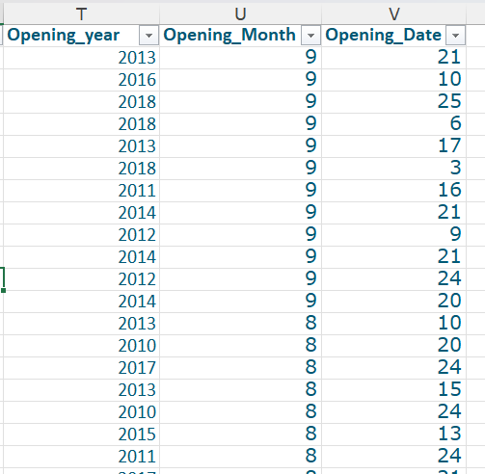
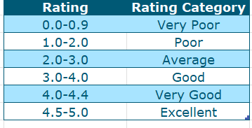
Zomato Restaurant Analysis
Data Transformation
Added the countries name in the original data using the country code (provided in separate worksheet)
Extracted Year from Datekey_opening and stored under the column Opening_Year, Opening_Month & Opening_Date
Ratings were categorized into different categories.

Slide 7
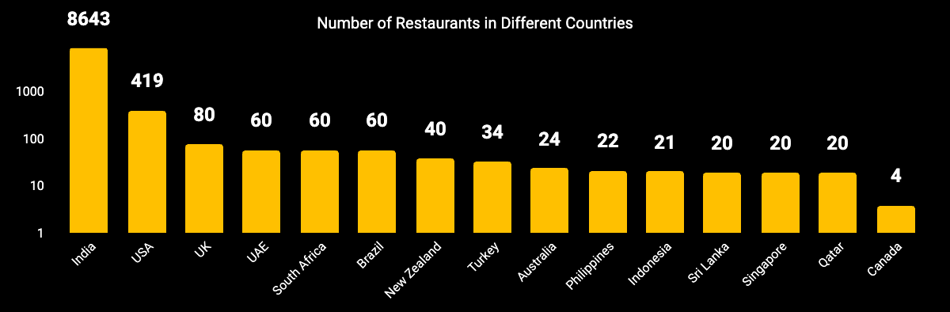

Zomato Restaurant Analysis
India has the maximum number of restaurants (8643). It has significant large number of restaurants in comparison to other restaurants.
Countries like Brazil, UAE & South Africa have equal number of restaurants (60). Similarly countries like Australia, Philippines, Indonesia, Singapore, Sri Lanka & Qatar have almost same number of restaurants (between 20 -24)
Canada has the least number of restaurants (4) among all the countries.

Slide 8
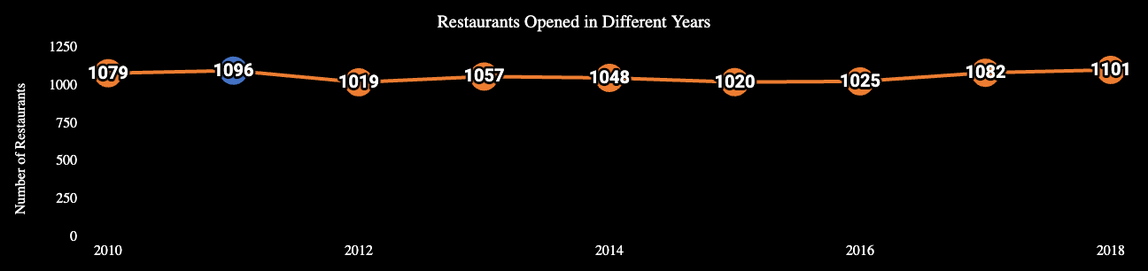
Zomato Restaurant Analysis
Year 2011 has the maximum number of restaurants (1096) opened. On the other hand, year 2012 has the least number of restaurants (1019) opened.
There was a fall in number of restaurants which were opened in a particular year 3 times.
2011 to 2012, then the decline was seen from 2013 to 2014 and then in 2014 to 2015.
More number of restaurants were opened in 2011 in comparison to 2010. Another increase was seen in 2013 as compared to 2014. And then from 2015, the number of restaurants kept on increasing till 2018.

Slide 9
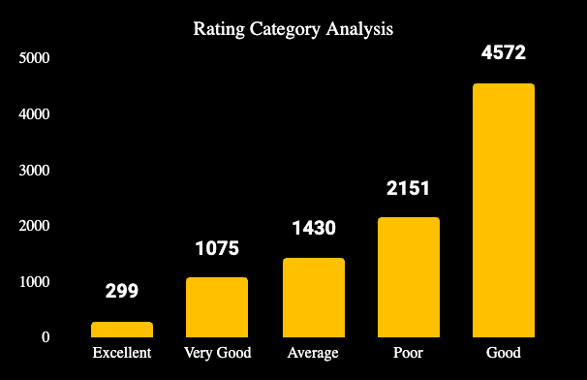
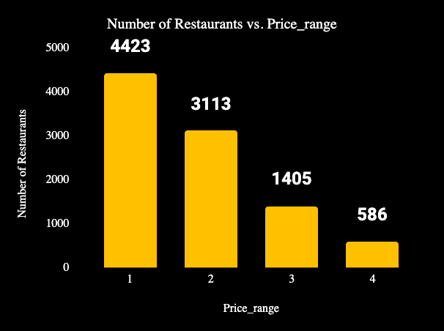
Zomato Restaurant Analysis
The price range shows a continuous decline in number of restaurants. Maximum number of restaurants have a price range of 1 where as least number of restaurants have price range of 4
Maximum number of restaurants were considered as Good rated restaurants. For these restaurants, ratings lie between 3.0 – 4.0

Slide 10
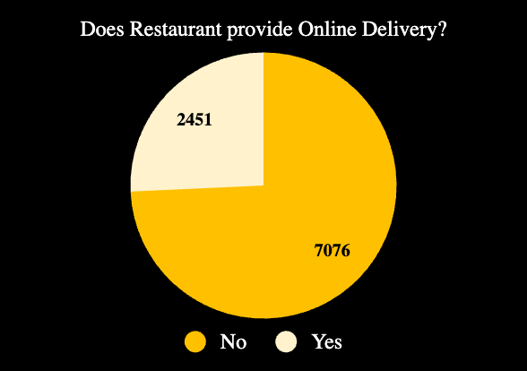
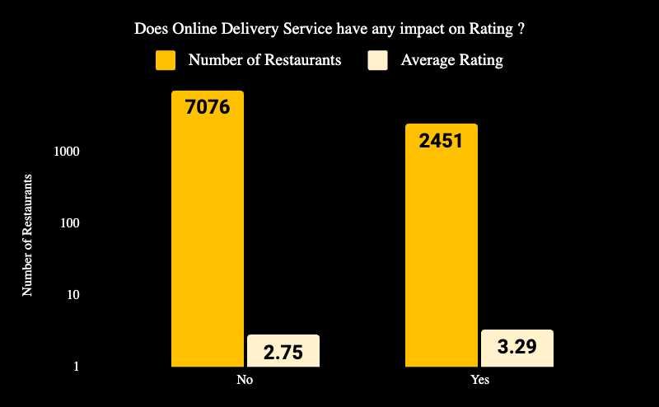
Zomato Restaurant Analysis
Restaurants with Online Delivery have Average Rating of 3.29 Restaurants without online delivery have Average Rating of 2.75
7076 – No Online Delivery
Almost 3/4th restaurants don’t have
the facility to provide online delivery

Slide 11
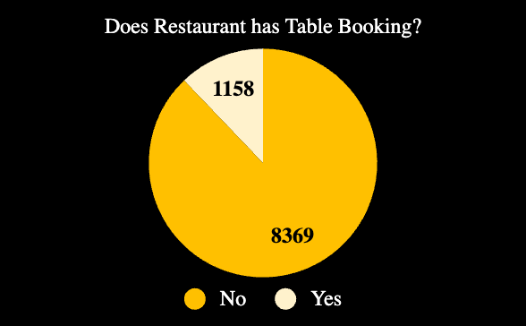
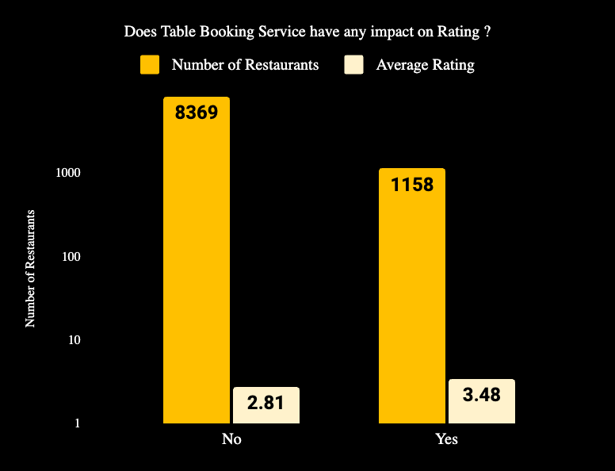
Zomato Restaurant Analysis
Restaurants with Online Delivery have Average Rating of 3.48 Restaurants without online delivery have Average Rating of 2.81
8369 – No Table Booking
Most of the restaurant doesn’t provide the convenience of table booking to the customers.

Slide 12
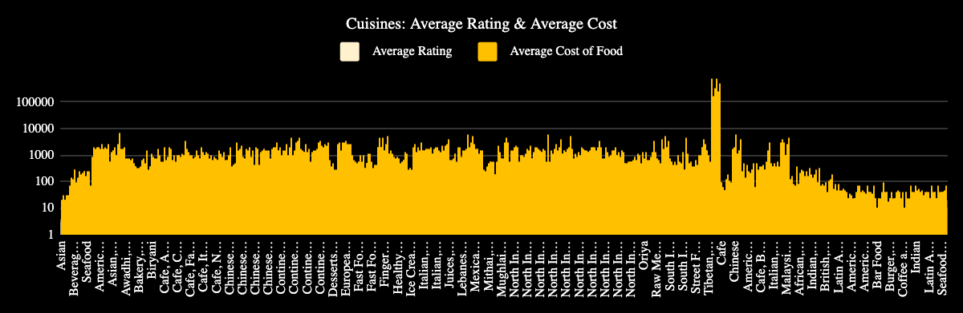
Zomato Restaurant Analysis
1,821
There are lot many varieties of cuisines available in restaurants all over the world
0.07
There is no correlation between Avg
Cost of Cuisines with Ratings
Correlation
0.07

Slide 13
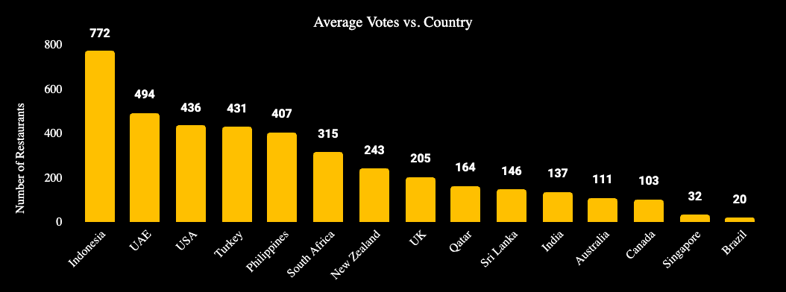
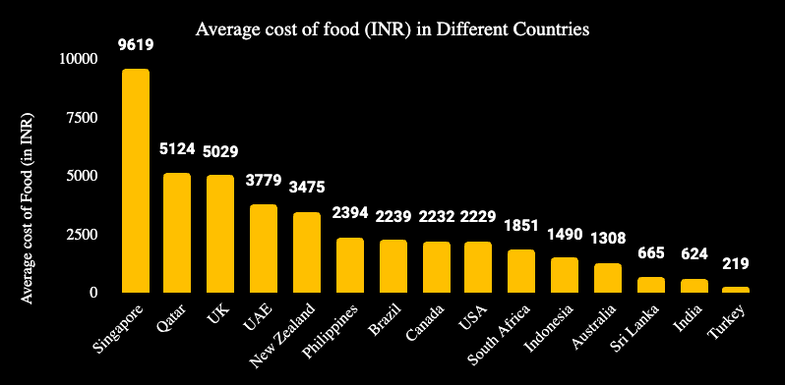
Zomato Restaurant Analysis
Restaurants in Indonesia received maximum voting (average of 772)
Restaurants in Brazil received minimum voting (average of 20)
Restaurants in Singapore has maximum average cost of food (average of 9619)
Restaurants in Turkey have least average cost of food
(average of Rs 219 )

Slide 14
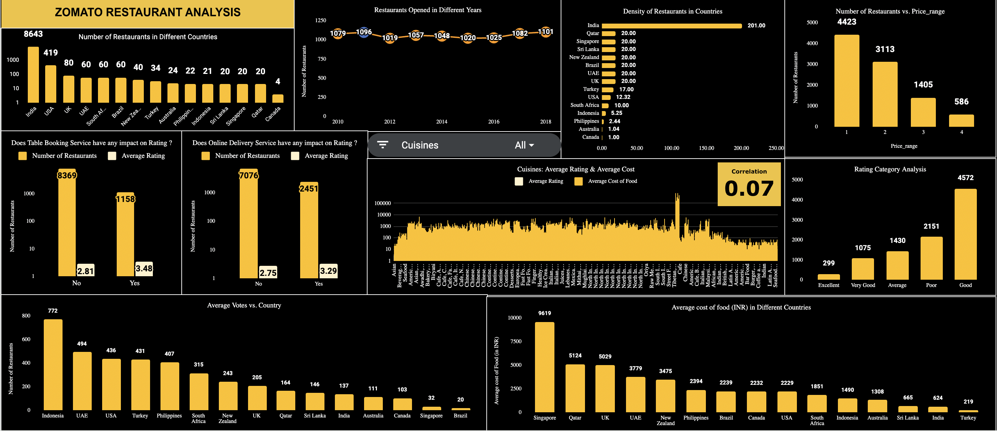
Zomato Restaurant Analysis
DASHBOARD
Dashboard Link
https://docs.google.com/spreadsheets/d/1VsYIyIxkwFox7Y2BylIqy11Yd5QsLN1yE0TlzGW6x5E/edit?usp=sharing

Slide 15
Thank You

